Slide 1
Web Scrapers/Crawlers
Aaron Neyer - 2014/02/26

Slide 2
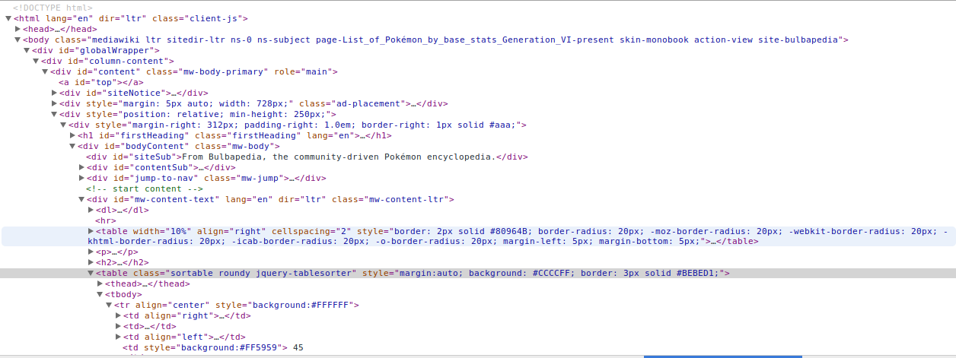
Scraping the Web
Optimal - A nice JSON API
Most websites don’t give us this, so we need to try and pull the information out

Slide 3
How to scrape?
Fetch the HTML source code
python: urllib
ruby: open-uri
Parse it!
Regex/String search
XML Parsing
HTML/CSS Parsing
python: lxml
ruby: nokogiri

Slide 4
Examine the HTML Source
Find the information you need on the page
Look for identifying elements/classes/ids
Test out finding the elements with Javascript CSS selectors

Slide 5
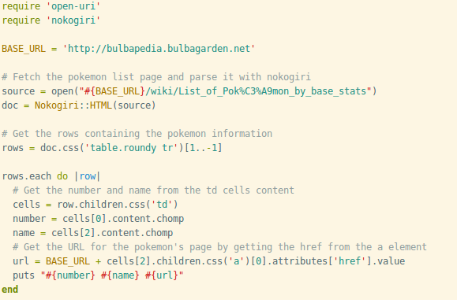
Let’s find some Pokemon!

Slide 6
What about session?
Some pages require you to be logged in
A simple curl won’t do
Need to maintain session
Solution?
python: scrapy
ruby: mechanize

Slide 7
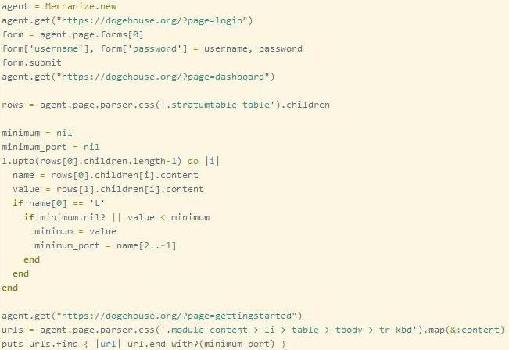
Want to mine some Dogecoins?

Slide 8
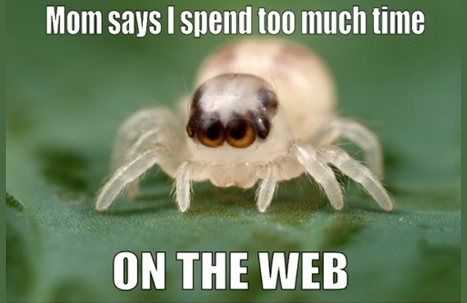
What is a web crawler?
A program that systematically scours the web, typically for the purpose of indexing
Used by search engines (Googlebot)
Known as spiders

Slide 9
How to build a web crawler
Need to create an index of words => URLs
Start with a source page and map all words on the page to it’s URL
Find all links on the page
Repeat for each of those URL’s
Here is a simple example:

Slide 10
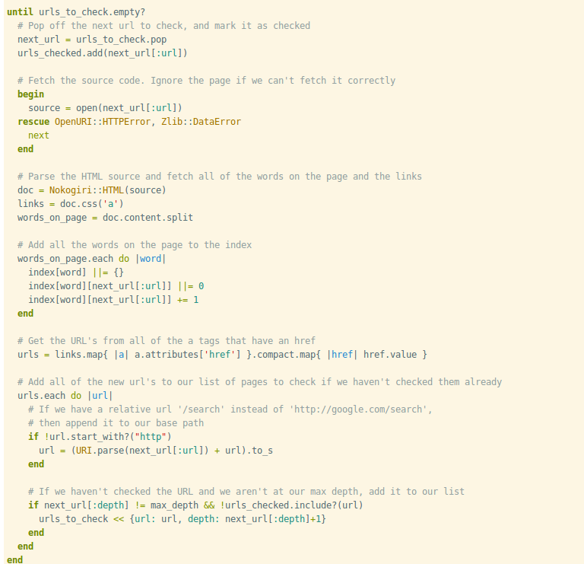

Slide 11
Some improvements
Handle URL’s better
Better content extraction
Better ranking of pages
Multithreading for faster crawling
Run constantly, updating index
More efficient storage of index
Use sitemaps for sources

Slide 12
Useful Links
Nokogiri: http://nokogiri.org/
lxml: http://lxml.de/
Mechanize: http://docs.seattlerb.org/mechanize/
Scrapy: http://scrapy.org/
HacSoc talks: http://hacsoc.org/talks/

Slide 13
Any Questions?

